Slide 1

Web and Information Technology
PROJECT
Team Members
Bishal Karmakar
Laishram Venushri Devi

Slide 2


CONTENTS
1. Login Page
2. Registration Page
3. Exam City Page
4. Personal Details
5. Address Page
6. Education Page
7.Document Page
8. Payment Page
9. Declaration Page
10. Forgot Credential
11. View Application Page

Slide 3



TECHNOLOGIES USED
HTML
CSS
JAVASCRIPT
check the website
https://bishal-35.github.io/user-registration/

Slide 4
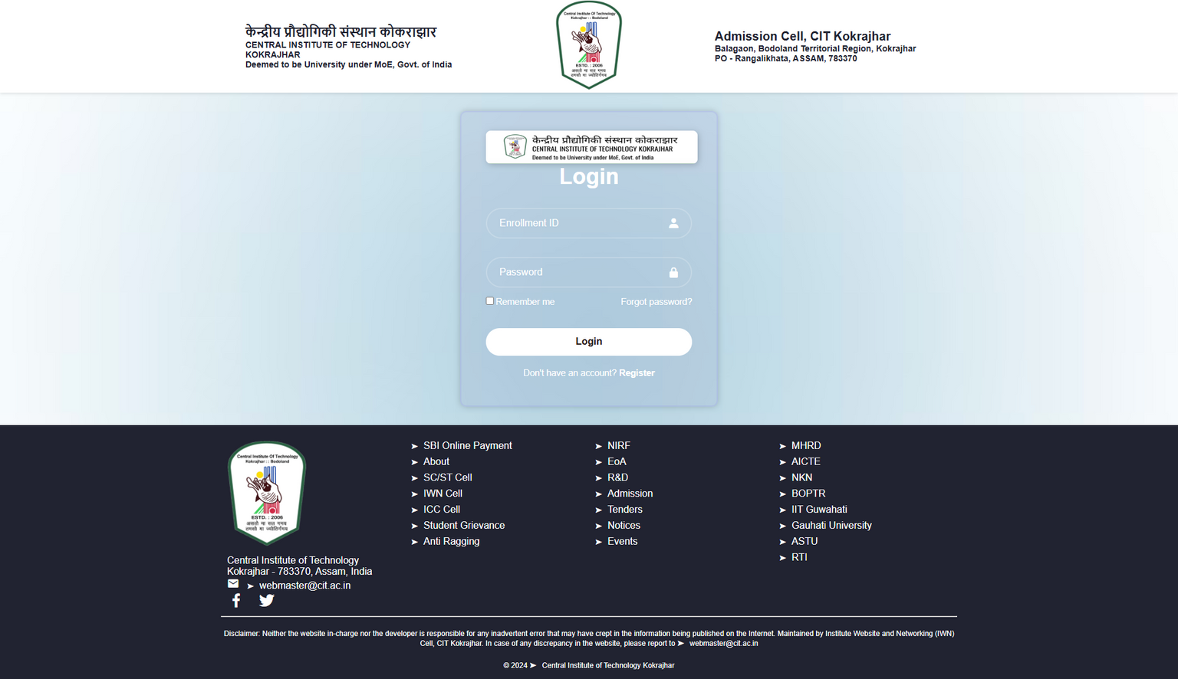
Login
page
check the website
https://bishal-35.github.io/user-registration/

Slide 5
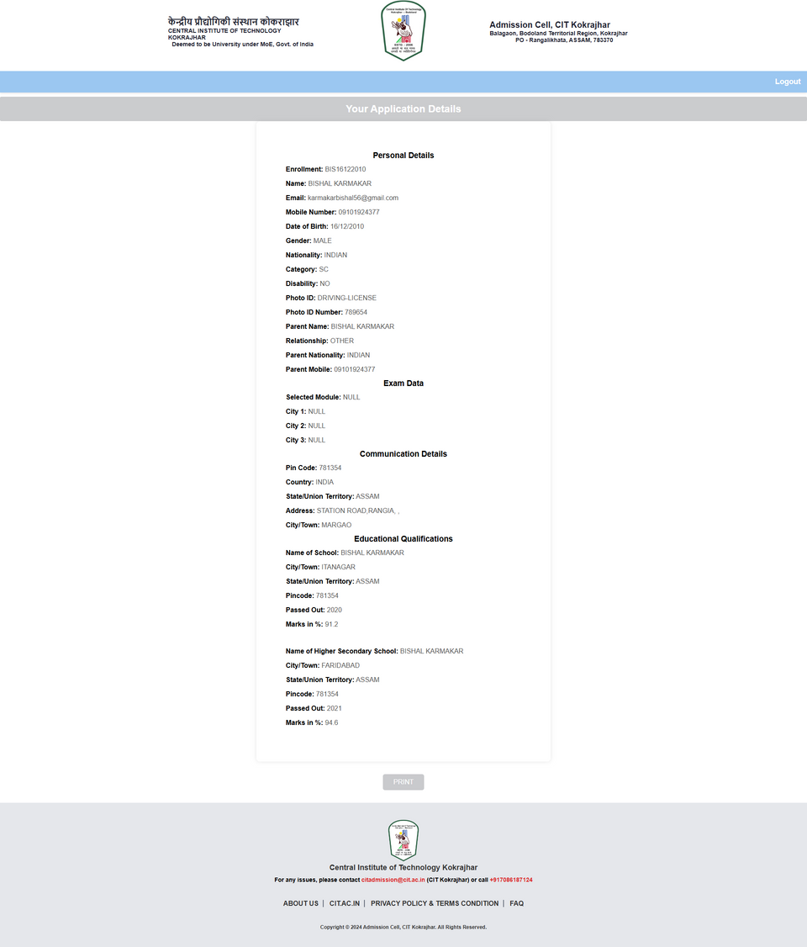
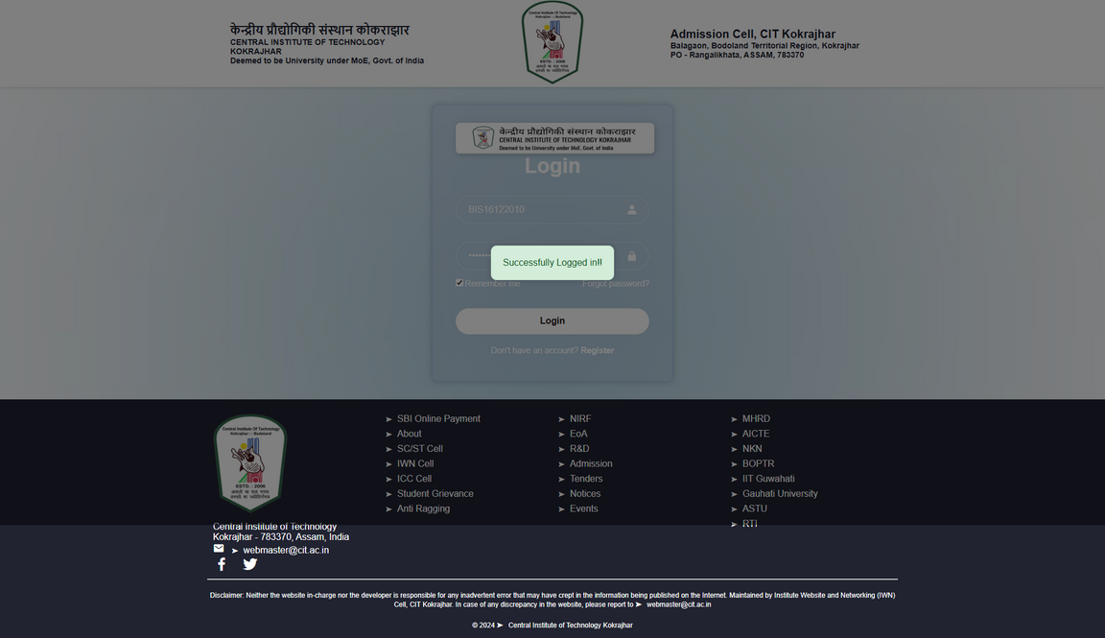
Login
page
Application Details
Successful login
check the website
https://bishal-35.github.io/user-registration/

Slide 6
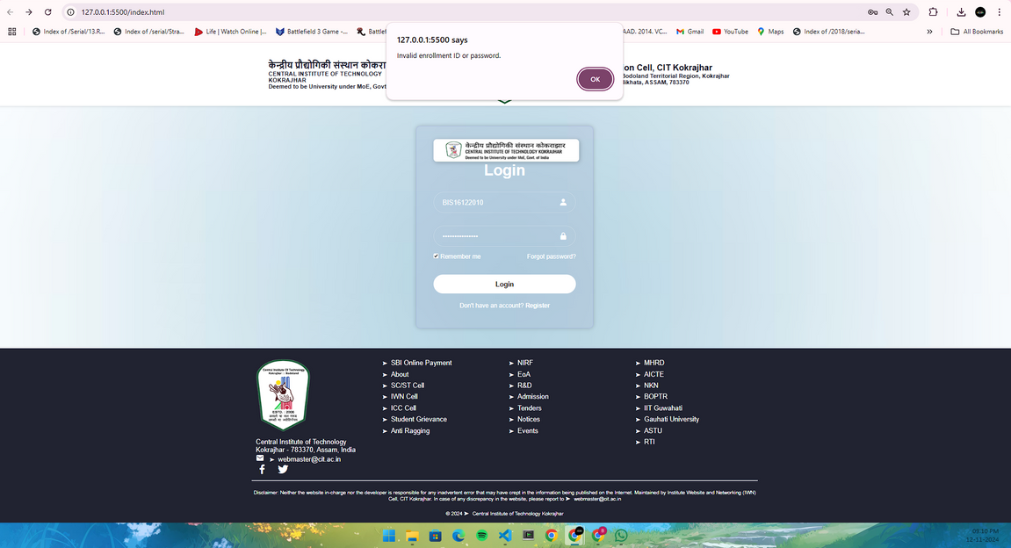
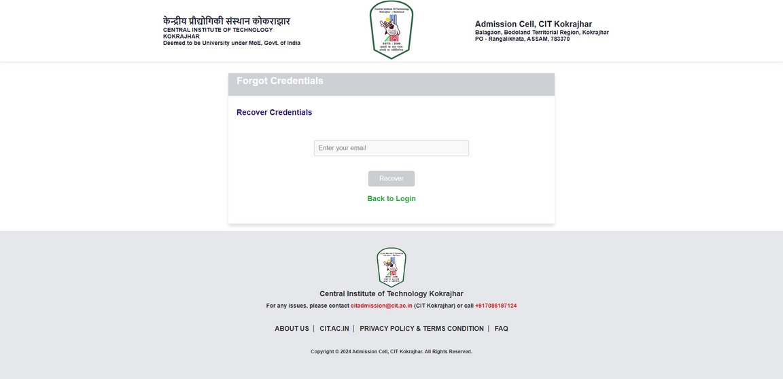
Login
page
Reset Password
Unsuccessful login
check the website
https://bishal-35.github.io/user-registration/

Slide 7
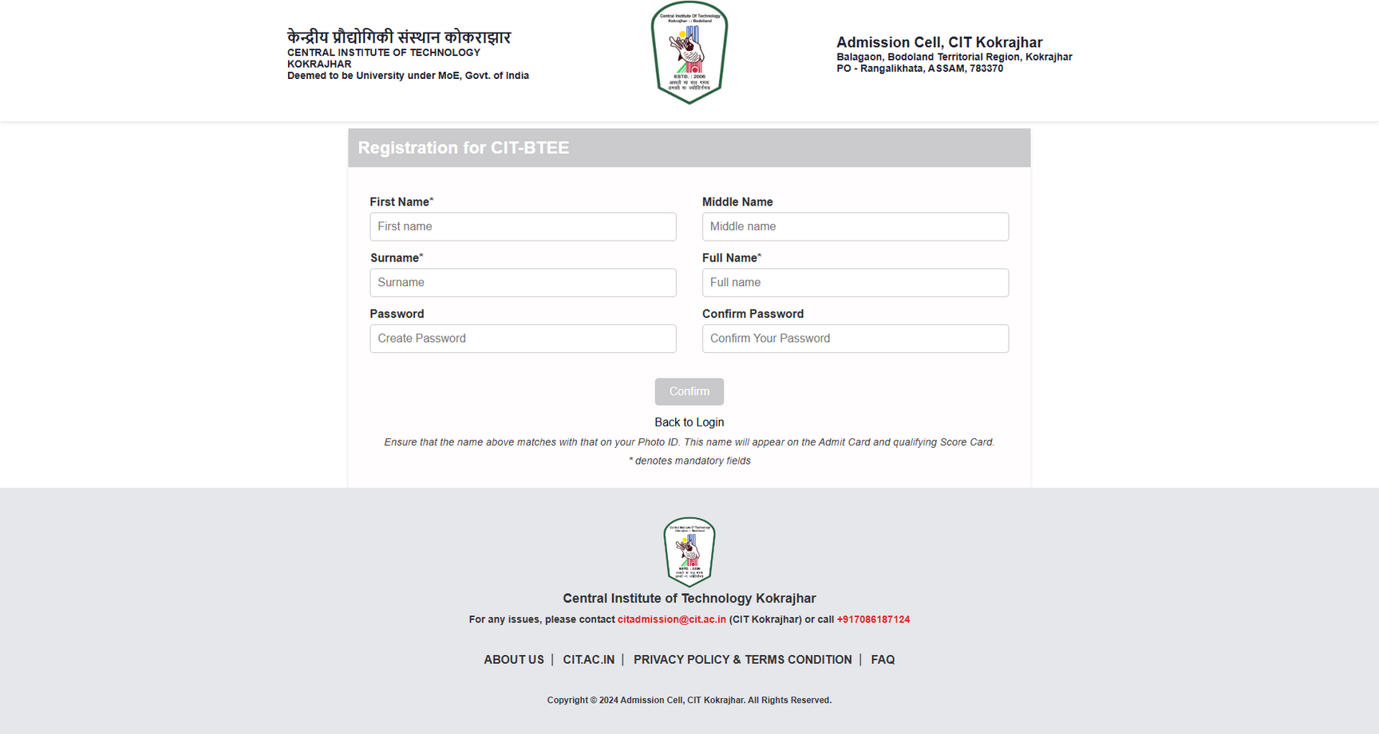
Registration
page
check the website
https://bishal-35.github.io/user-registration/

Slide 8
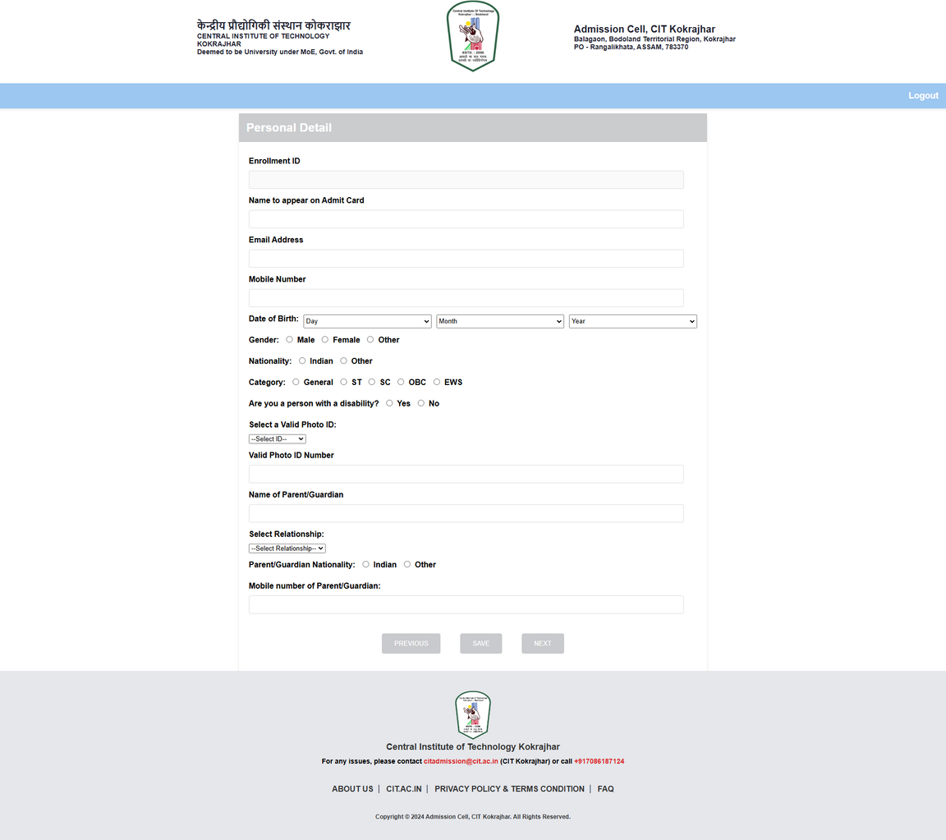
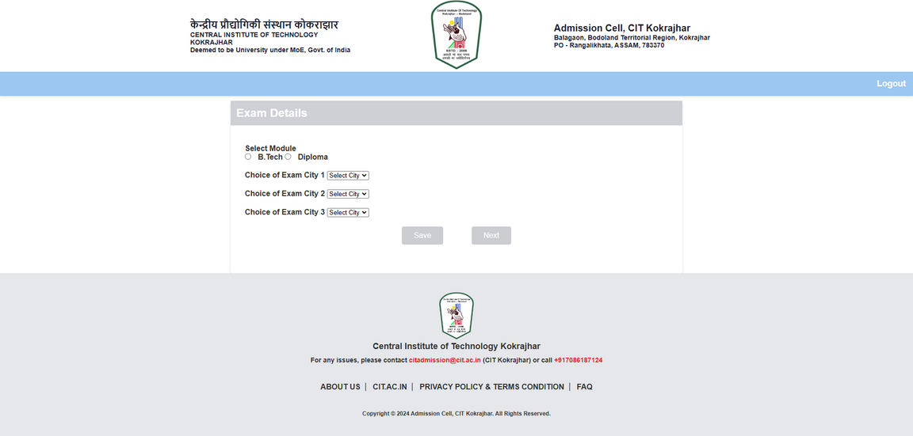
Registration
page
Personal Details
Exam City Details
check the website
https://bishal-35.github.io/user-registration/

Slide 9
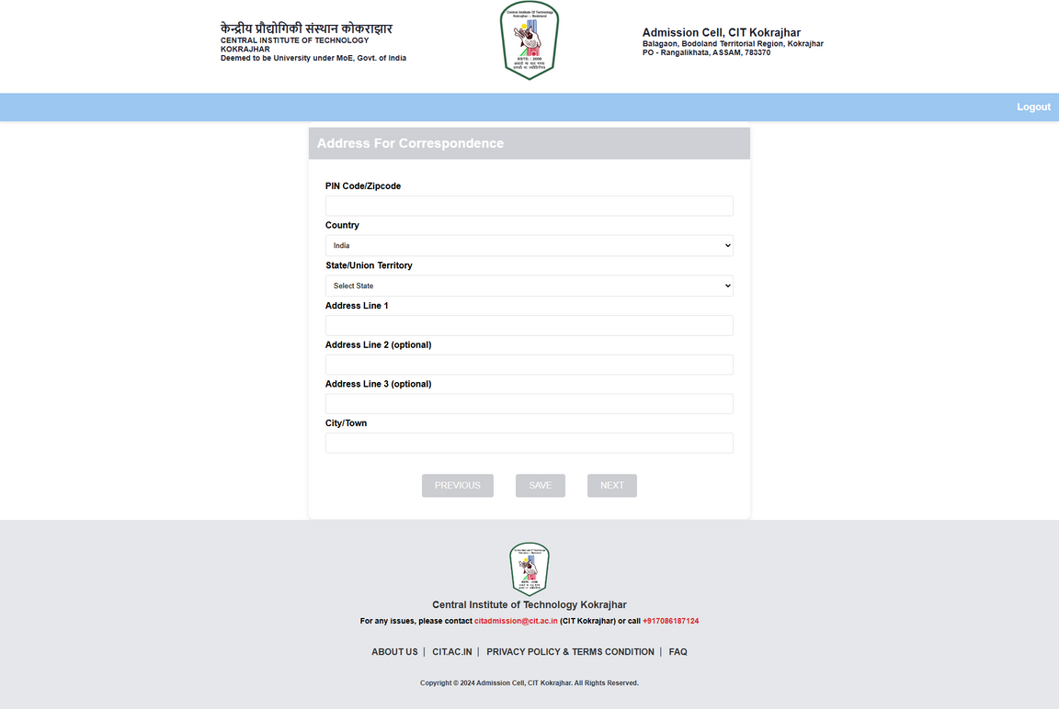
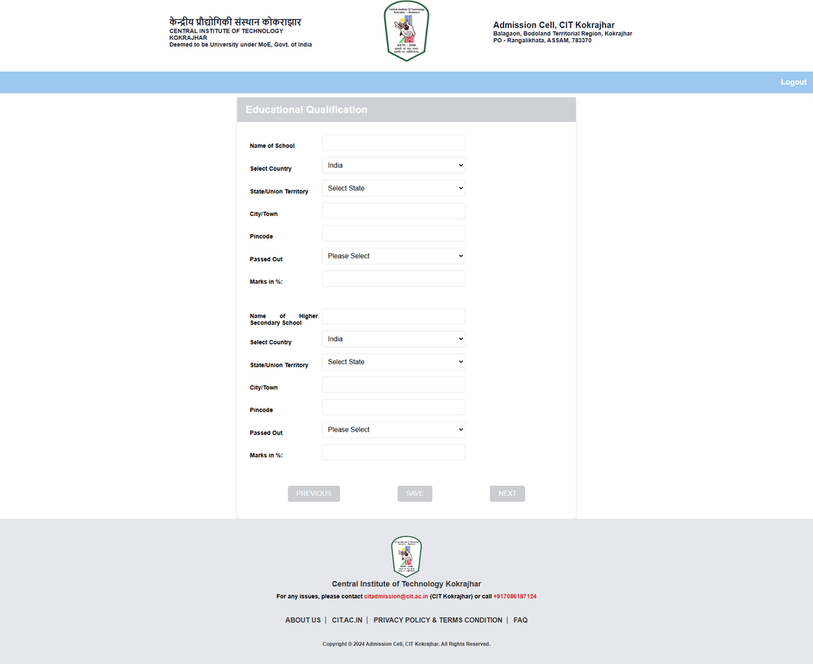
Registration
page
Education Details
Address Details
check the website
https://bishal-35.github.io/user-registration/

Slide 10

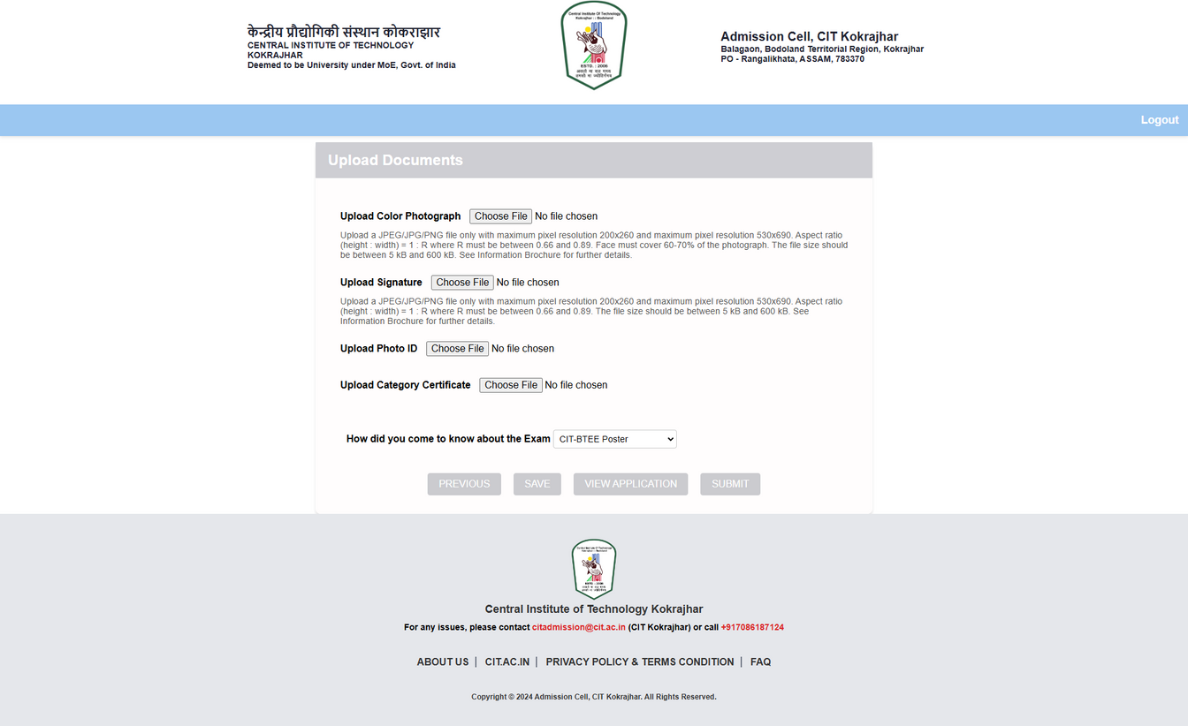
View Application
Registration
page
Upload Documents
check the website
https://bishal-35.github.io/user-registration/

Slide 11
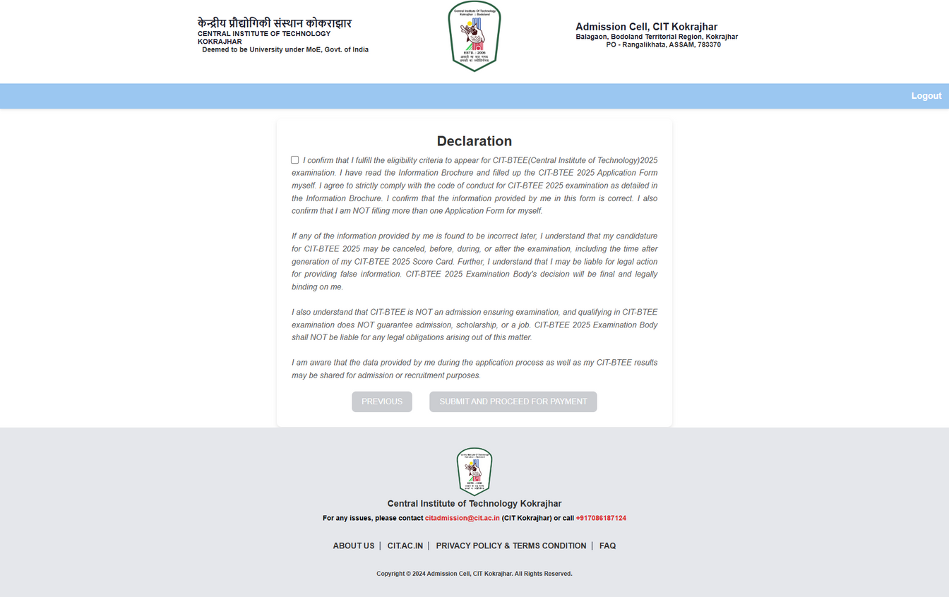
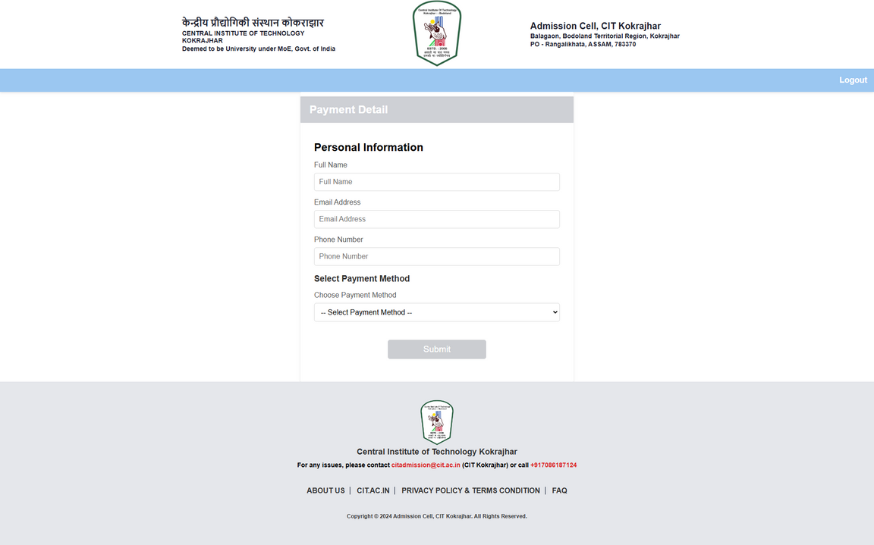
Registration
page
Payment Details
Declaration
check the website
https://bishal-35.github.io/user-registration/

Slide 12
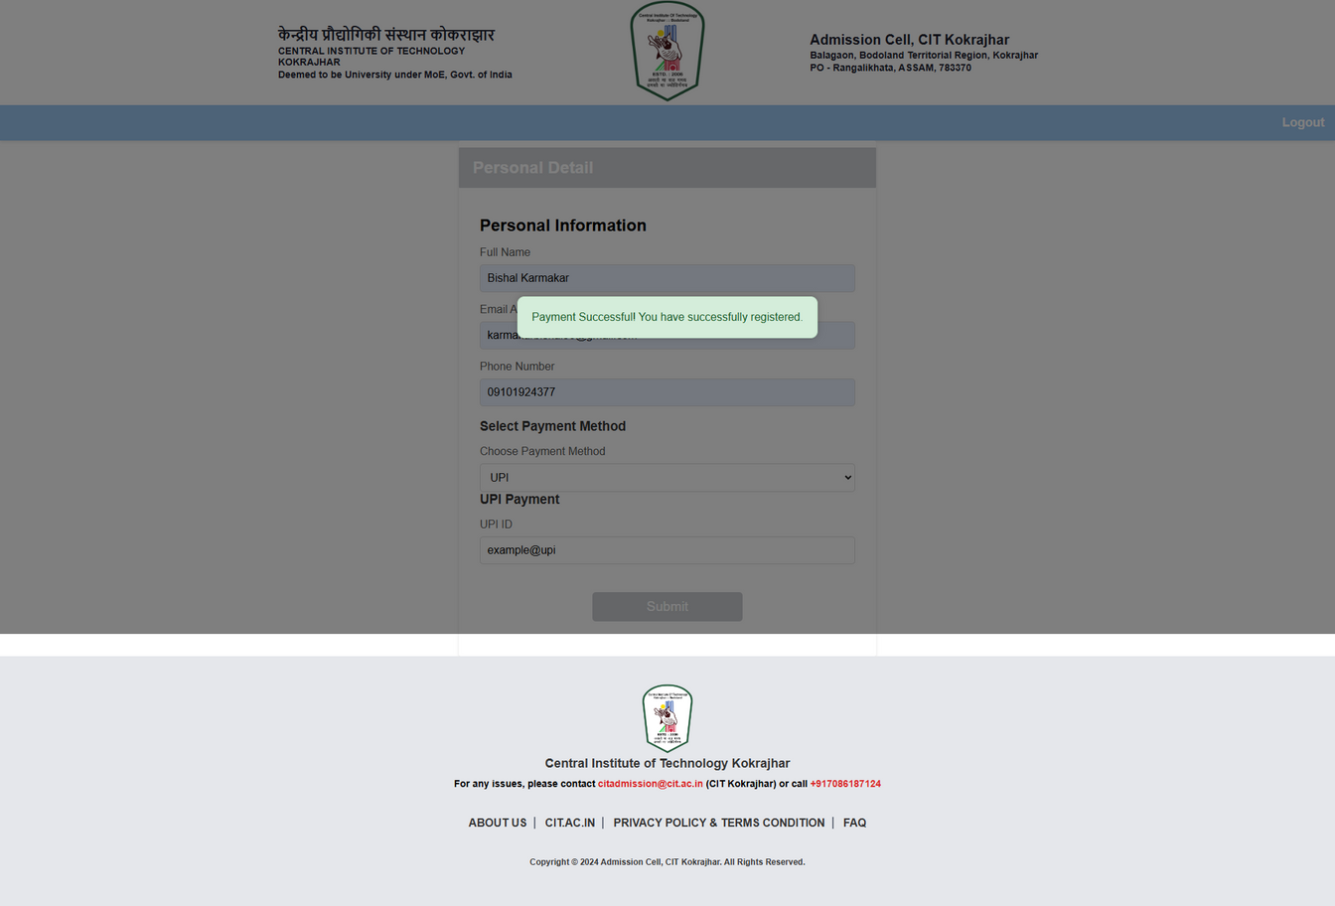
Application Details
Registration
page
Payment Successful
check the website
https://bishal-35.github.io/user-registration/

Slide 13
Thank You

